Slide 1
Porter’s Competitive Forces
Computer Systems Management
Module Code CT012-3-3
Level 3
VD1

Slide 2
Competitive Advantage
Competitive advantage refers to factors that allow a company to produce goods or services better or more cheaply than its rivals.
These factors allow the productive entity to generate more sales or superior margins compared to its market rivals.
Competitive advantages are attributed to a variety of factors including cost structure, branding, the quality of product offerings, the distribution network, intellectual property, and customer service.

Slide 3
Competitive advantage is what makes an entity's products or services more desirable to customers than that of any other rival.
Competitive advantages can be broken down into comparative advantages and differential advantages.
Comparative advantage is a company's ability to produce something more efficiently than a rival, which leads to greater profit margins.
A differential advantage is when a company's products are seen as both unique and of higher quality, relative to those of a competitor.

Slide 4
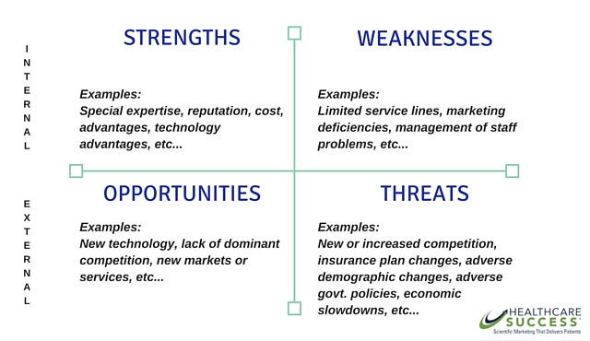
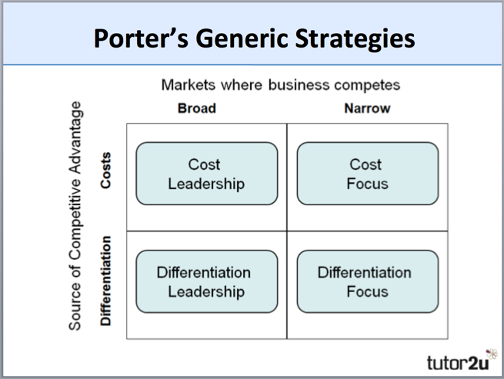
Learning Outcomes
1. Competitive Advantage Strategies
Cost Leadership
Differentiation
Focus or Niche
Innovation
Growth
Alliance
2. SWOT Analysis

Slide 5
Content
Competitive Forces
SWOT Analysis

Slide 6
Key Terms
Competitive Advantage, Cost Leadership
Differentiation, Focus or Niche
Innovation, Growth, Alliance
SWOT Analysis

Slide 7
Cost Leadership
Business becomes market leader by
operating at the lowest cost amongst all firms in the industry
Cost effective and value provider to lead competition
Find ways to drive costs out of business year-after-year
Make achievement of low-cost relative to rivals the theme of firm’s business strategy
It means low overall costs not just low manufacturing or production costs
Notes:
Overall cost leadership
Differentiation
Focus

Slide 8
Cost Leadership
Usually aimed at a broad market, so sufficient sales to cover costs. E.g. AirAsia, Walmart
Walmart offers cheaper products than competitors consistently rather than relying on periodic sales. How?
  Through large scale, efficient supply chain, sourcing products from cheap domestic suppliers and low-wage foreign markets
  Allowing them to sell at low prices and to profit off thin margins at a high volume
Notes:
overall

Slide 9
A. Value Chain Using Traditional Channels - Highest Cost
Cost Leadership
Software development activities
CD-ROM production and packaging activities
Marketing and promotion of software
Warehousing and shipping of wholesaler-retailer orders
Technical support activities
Activities of software retailers
Activities of wholesale distributors of software products
C. Value Chain Using Online Sales and Internet Delivery - Lowest Cost
Software development activities
Online marketing and promotion activities
Systems to accept credit card payment and
allow immediate download
Technical support and customer service activities

Slide 10
Cost Leadership
Advantage
  Price competition is vigorous
  Product is standardized
  Industry newcomers use introductory low prices to attract buyers and build customer base
Disadvantage
  Being overly aggressive in cutting price
  Low cost methods are easily imitated by rivals
  Differentiation matters
Notes:
Firms that succeed have high level of expertise in manufacturing, efficient distribution channels

Slide 11
Differentiation
  Product or service must be unique to sustain
  customer preference and loyalty
  Incorporate differentiating features for buyers to prefer firm’s product over rivals
This strategy allows a firm to:
  sell products at premium price
  create barrier to entry of new competitors
  earn above average profits by reducing elasticity of demand
Elasticity of demand - economic principle that measures extent of consumer response as price changes (other factors remain). It shows how many products customers are willing to purchase as the prices of these products increases or decreases.
Notes:
create value

Slide 12
Differentiation
Advantage
  There are many ways to differentiate a product that to please customers e.g products, services, image
  Buyer needs and uses are diverse
  Technological change and product innovation are fast-paced
Disadvantage
  Charging too high a price or over differentiating
  Failing to signal value
  Not understanding what buyers want or prefer and differentiating on the “wrong” things
Notes:
Firms that succeed have a highly skilled & creative product development team, access to leading scientific research, reputation for innovation & quality.

Slide 13
First Mover
First Mover
Advantages Disadvantages
Reputation for being innovative and industry leader
Cost and learning benefits resulting from moving along experience curve first
Control over scarce assets preventing competitors from having access to them
Opportunity to begin building customer relationships and customer loyalty
Uncertain over exact direction technology and market will go
Risk of competitors imitating innovations (free-rider effect)
Financial and strategic risks
High development costs
An organization that’s first to bring a new product innovation to the marketplace or to use a new process innovation is called a first mover. Video
Notes:
An organization that’s first to bring a new product innovation to the marketplace or to use a new process innovation is called a first mover. As shown in the slide, being a first mover has certain strategic advantages and disadvantages.

Slide 14
Focus or Niche
Product development is focused, customer
requirements fulfilled. Concentration on quality of product and target market.
Concentrated attention on narrow piece of the total market e.g. Rolls Royce and Bentley
Objective - Serve niche buyers better than rivals
Keys to success
  Choose market niche where buyers have distinctive preferences, special requirements or unique needs
  Develop unique capabilities to serve needs of target buyer segment
Notes:
A focus strategy is a cost leadership or differentiation strategy which does not target the whole market for a product or service, instead it targets a segment or limited number of segments of a market.

Slide 15
Focus or Niche
Advantage
  Able to identify large target market with distinct customer needs
  Buyers have distinctive preferences, special requirements, or unique needs
  Able to develop unique capabilities to serve needs of target buyers
Disadvantage
  Competitors find effective ways to match a focuser’s capabilities in serving niche
  Niche buyers’ preferences shift towards product attributes desired by majority of buyers
    niche becomes part of overall market
  Segment becomes so attractive it becomes crowded with rivals, causing segment profits to be splintered

Slide 16
Innovation and Growth
Innovation - new ways of doing business
  Unique products, services or unique markets
  Radical changes to business processes to alter fundamental structure of the industry
  Example: Amazon’s full-service customer systems
Growth - expansion
  Expand company’s capacity to produce
  Expand into global markets
  Diversify into new products or services
  Example: Walmart uses merchandise ordering by global satellite tracking and Amazon offers wide product assortment on its website
Notes:
Innovation Strategy
Growth Strategy : offers its services to retailers and consumer goods manufacturers such as Nordstrom, Target, Polo Ralph Lauren, OshKosh B'Gosh and others. These companies rent space on Amazon's online shopping mall and gain access to huge numbers of online shoppers and efficient customer-facing operations.

Slide 17
Alliance
Alliance
  Establish link and alliance with
    Customers, suppliers, competitors, consultants
  Includes mergers, acquisitions, joint ventures
    Company growth without expansion and cost
    Allows to test the market for growth potential
  Types of strategies
    Join forces to achieve economies of scale
    Use larger company's distribution network
    Pass useful knowledge down the chain
    Example: Walmart uses automatic inventory replenishment by supplier
Notes:
Join forces - A manufacturer of veneers and plywood joined forces with nine of its competitors to select a common transportation company
Use a network - To tap into the American market, it entered into an alliance with a large U.S. company
Pass useful knowledge - work with suppliers closely to develop new products and share knowledge and training to improve your production process

Slide 18
Alliance
Dell & Microsoft — Technology Alliance Partners
For more than 30 years, Dell and Microsoft have focused on delivering best-in-class, innovative managed services and solutions that span the entire Microsoft product portfolio. Today, Dell EMC is one of the world’s largest Microsoft solution providers for both Cloud and on premises solutions
Apple
Apple partnered with Sony, Motorola, Phillips and AT&T and Clearwell to jointly develop Clearwell's E-Discovery platform for the Apple iPad. E-Discovery is used by enterprises and legal entities to obtain information in a "legally defensible" manner

Slide 19
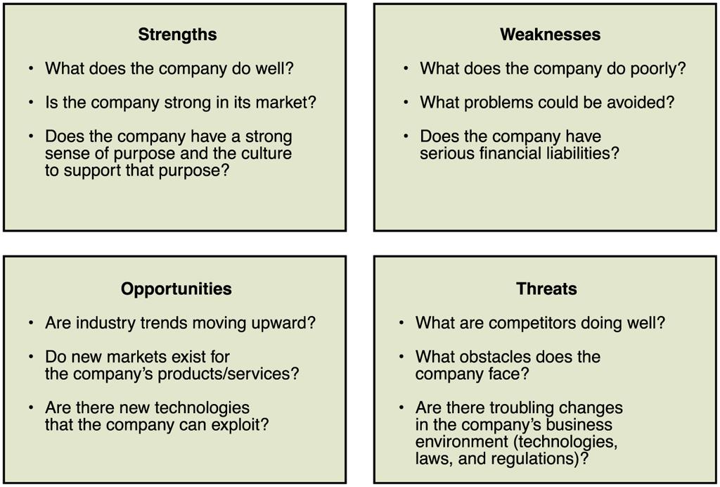
SWOT Analysis

Slide 20
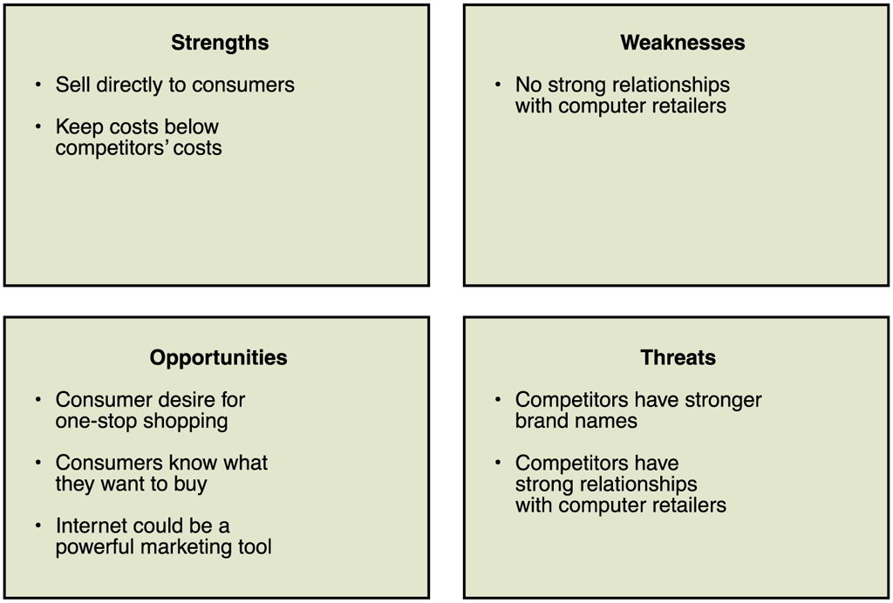
SWOT Analysis - DELL

Slide 21
Summary
Question and Answer Session
1. Competitive Advantage Strategies
Cost Leadership
Differentiation
Focus or Niche
Innovation
Growth
Alliance
2. SWOT Analysis – Strength, Weakness, Opportunity, Threats
3. First Mover - an organization that’s first to bring a new product innovation to the marketplace or to use a new process innovation

Slide 22
Review Questions
Question and Answer Session
How does a business become a market leader
Describe the meaning of a First Mover organization

Slide 23

Question and Answer Session
Question and Answer Session
Q & A

Slide 24
What We will Cover Next
Question and Answer Session
Information Systems Strategy

